Slide 1

Neural Architecture Search: Basic Approach, Acceleration and Tricks
Speaker: Lingxi Xie (谢凌曦)
Noah’s Ark Lab, Huawei Inc. (华为诺亚方舟实验室)
Slides available at my homepage (TALKS)

Slide 2
Take-Home Messages
Neural architecture search (NAS) is the future
Deep learning makes feature learning automatic
NAS makes deep learning automatic
The future is approaching faster than we used to think!
2017: NAS appears
2018: NAS becomes approachable
2019 and 2020: NAS will be mature and a standard technique

Slide 3
Outline
Introduction
Framework
Representative Work
Our New Progress
Future Directions

Slide 4
Outline
Introduction
Framework
Representative Work
Our New Progress
Future Directions

Slide 5
Introduction: Neural Architecture Search
Neural Architecture Search (NAS)
Instead of manually designing neural network architecture (e.g., AlexNet, VGGNet, GoogLeNet, ResNet, DenseNet, etc.), exploring the possibility of discovering unexplored architecture with automatic algorithms
Why is NAS important?
A step from manual model design to automatic model design (analogy: deep learning vs. conventional approaches)
Able to develop data-specific models
[Krizhevsky, 2012] A. Krizhevsky et al., ImageNet Classification with Deep Convolutional Neural Networks, NIPS, 2012.
[Simonyan, 2015] K. Simonyan et al., Very Deep Convolutional Networks for Large-scale Image Recognition, ICLR, 2015.
[Szegedy, 2015] C. Szegedy et al., Going Deeper with Convolutions, CVPR, 2015.
[He, 2016] K. He et al., Deep Residual Learning for Image Recognition, CVPR, 2016.
[Huang, 2017] G. Huang et al., Densely Connected Convolutional Networks, CVPR, 2017.

Slide 6
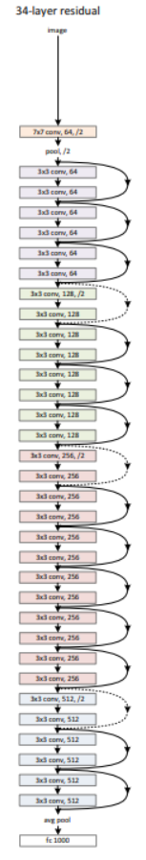
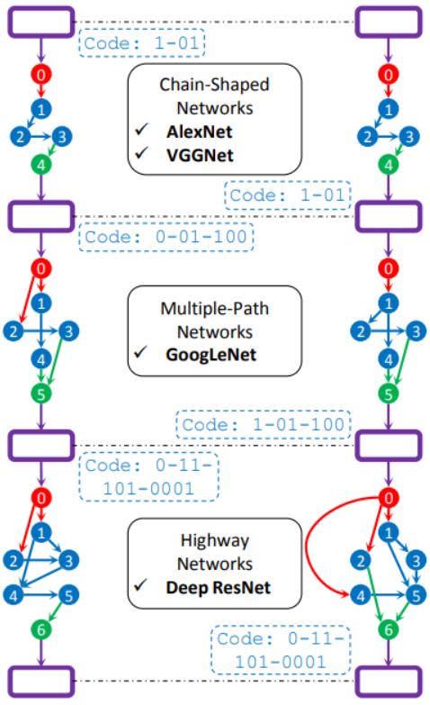
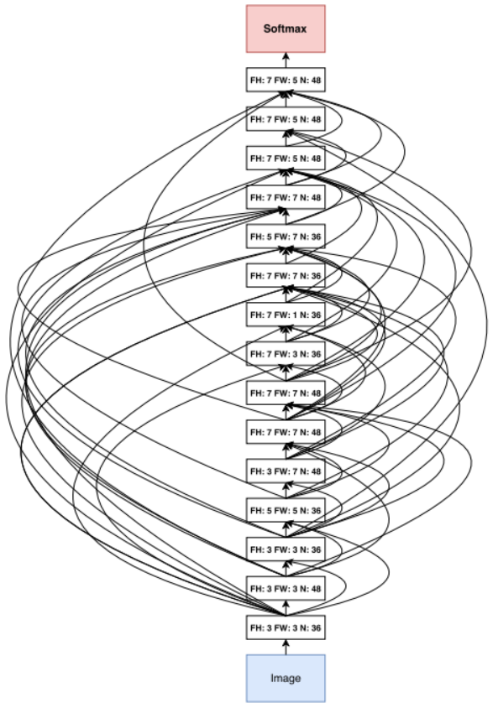
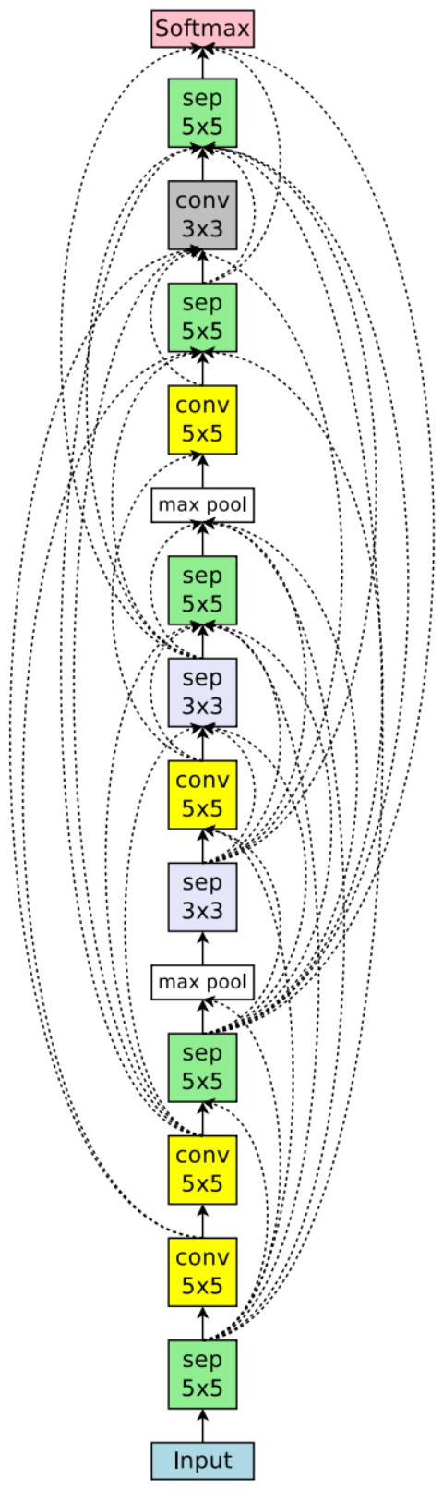
Introduction: Examples and Comparison
Model comparison: ResNet, GeNet, NASNet and ENASNet
[He, 2016] K. He et al., Deep Residual Learning for Image Recognition, CVPR, 2016.
[Xie, 2017] L. Xie et al., Genetic CNN, ICCV, 2017.
[Zoph, 2018] B. Zoph et al., Learning Transferable Architectures for Scalable Image Recognition, CVPR, 2018.
[Pham, 2018] H. Pham et al., Efficient Neural Architecture Search via Parameter Sharing, ICML, 2018.

Slide 7
Outline
Introduction
Framework
Representative Work
Our New Progress
Related Applications
Future Directions

Slide 8
Framework: Trial and Update
Almost all NAS algorithms are based on the “trial and update” framework
Starting with a set of initial architectures (e.g., manually defined) as individuals
Assuming that better architectures can be obtained by slight modification
Applying different operations on the existing architectures
Preserving the high-quality individuals and updating the individual pool
Iterating till the end
Three fundamental requirements
The building blocks: defining the search space (dimensionality, complexity, etc.)
The representation: defining the transition between individuals
The evaluation method: determining if a generated individual is of high quality

Slide 9
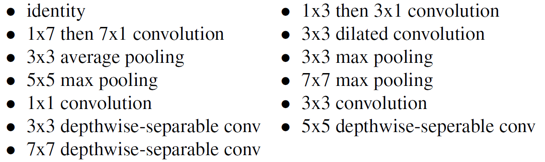

Framework: Building Blocks
Building blocks are like basic genes for these individuals
Some examples here
Genetic CNN: only $3×3$ convolution is allowed to be searched (followed by default BN and ReLU operations), $3×3$ pooling is fixed
NASNet: $13$ operations shown below
PNASNet: $8$ operations, removing those never-used ones from NASNet
ENASNet: $6$ operations
DARTS: $8$ operations
[Xie, 2017] L. Xie et al., Genetic CNN, ICCV, 2017.
[Zoph, 2018] B. Zoph et al., Learning Transferable Architectures for Scalable Image Recognition, CVPR, 2018.
[Liu, 2018] C. Liu et al., Progressive Neural Architecture Search, ECCV, 2018.
[Pham, 2018] H. Pham et al., Efficient Neural Architecture Search via Parameter Sharing, ICML, 2018.
[Liu, 2019] H. Liu et al., DARTS: Differentiable Architecture Search, ICLR, 2019.

Slide 10
Framework: Search
Finding new individuals that have potentials to work better
Heuristic search in the large space
Two mainly applied methods: the genetic algorithm and reinforcement learning
Both are heuristic algorithms applied to the scenarios of a large search space and limited ability to explore every single element in the space
A fundamental assumption: both of these heuristic algorithms can preserve good genes and based on which discover possible improvements
Also, it is possible to integrate architecture search to network optimization
These algorithms are often much faster
[Real, 2017] E. Real et al., Large-Scale Evolution of Image Classifiers, ICML, 2017.
[Xie, 2017] L. Xie et al., Genetic CNN, ICCV, 2017.
[Zoph, 2018] B. Zoph et al., Learning Transferable Architectures for Scalable Image Recognition, CVPR, 2018.
[Liu, 2018] C. Liu et al., Progressive Neural Architecture Search, ECCV, 2018.
[Pham, 2018] H. Pham et al., Efficient Neural Architecture Search via Parameter Sharing, ICML, 2018.
[Liu, 2019] H. Liu et al., DARTS: Differentiable Architecture Search, ICLR, 2019.

Slide 11

Framework: Evaluation
Evaluation aims at determining which individuals are good and to be preserved
Conventionally, this was often done by training a network from scratch
This is extremely time-consuming, so researchers often train NAS on a small dataset like CIFAR and then transfer the found architecture to larger datasets like ImageNet
Even in this way, the training process is really slow: Genetic-CNN requires $17$ GPU-days for a single training process, and NAS-RL requires more than $20,000$ GPU-days
Efficient methods were proposed later
Ideas include parameter sharing (without the need of re-training everything for each new individual) and using a differentiable architecture (joint optimization)
Now, an efficient search process on CIFAR can be reduced to a few GPU-hours, though training the searched architecture on ImageNet is still time-consuming
[Xie, 2017] L. Xie et al., Genetic CNN, ICCV, 2017.
[Zoph, 2017] B. Zoph et al., Neural Architecture Search with Reinforcement Learning, ICLR, 2017.
[Pham, 2018] H. Pham et al., Efficient Neural Architecture Search via Parameter Sharing, ICML, 2018.
[Liu, 2019] H. Liu et al., DARTS: Differentiable Architecture Search, ICLR, 2019.

Slide 12
Outline
Introduction
Framework
Representative Work
Our New Progress
Future Directions

Slide 13
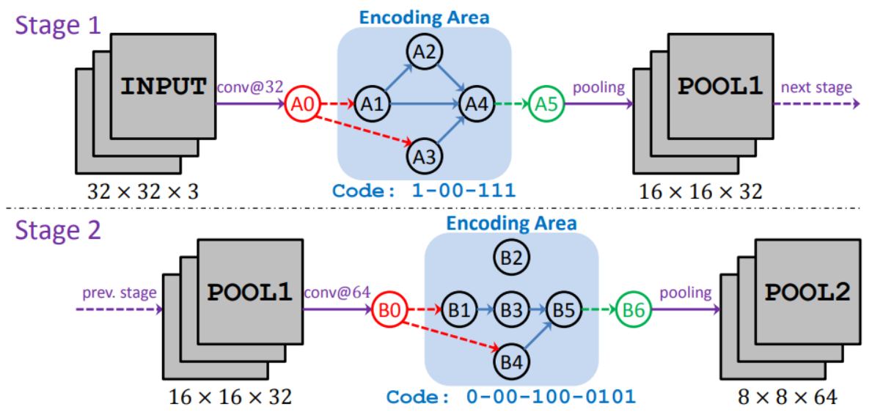
Genetic CNN
Only considering the connection between basic building blocks
Encoding each network into a fixed-length binary string
Standard operators: mutation, crossover, and selection
Limited by computation
Relatively low accuracy
[Xie, 2017] L. Xie et al., Genetic CNN, ICCV, 2017.

Slide 14
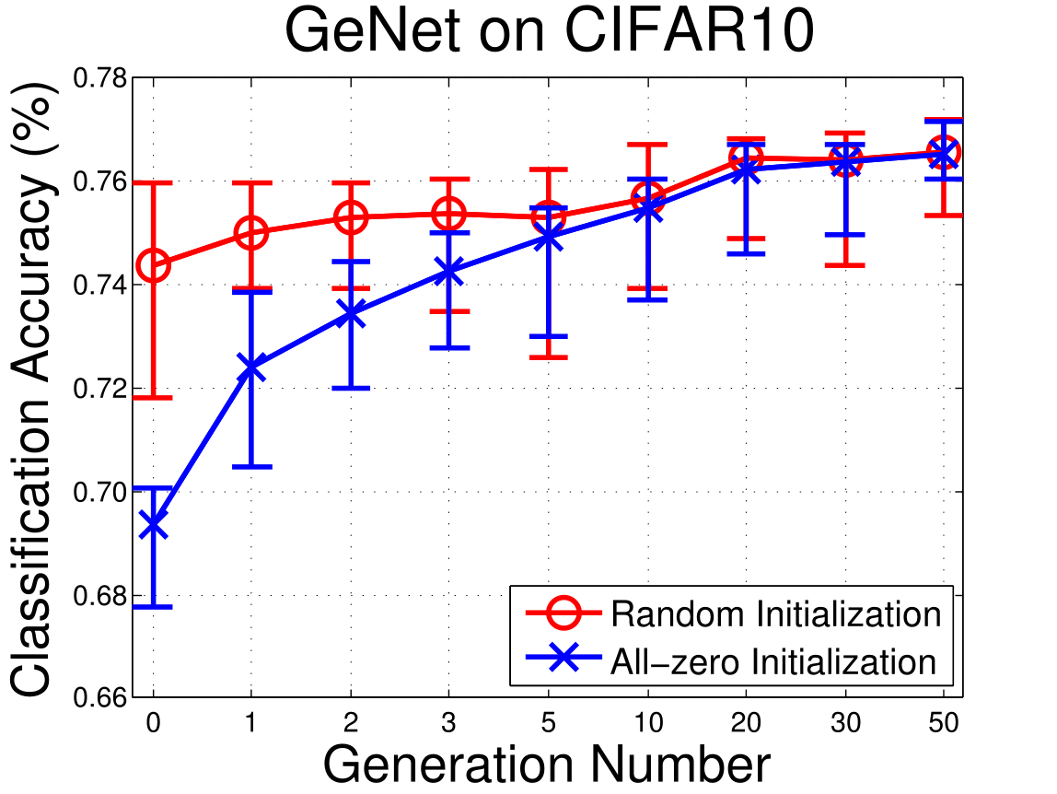
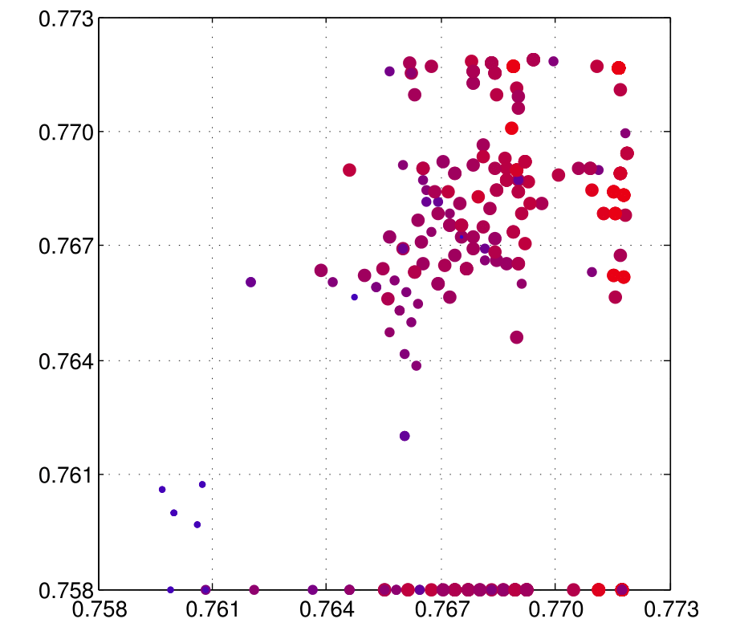
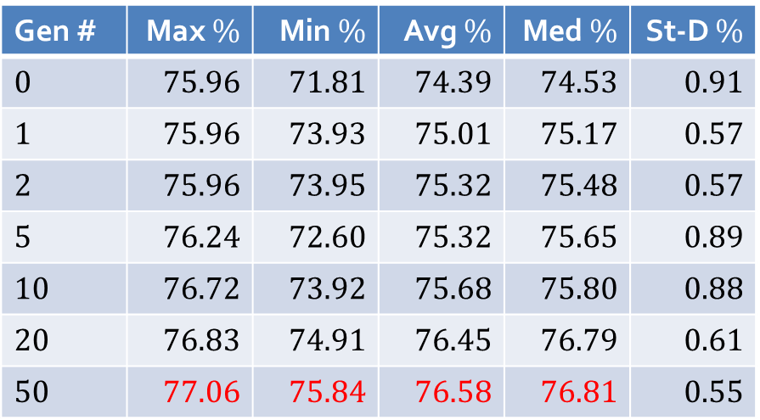

Genetic CNN
Figure: the impact of initialization is ignorable after a sufficient number of rounds
CIFAR10 experiments
$3$ stages, $\left\{K_{1},K_{2},K_{3}\right\}=\left\{3,4,5\right\}$, $L=19$
$N=20$ (individuals), $L=50$ (rounds)
Gen # | Max $\%$ | Min $\%$ | Avg $\%$ | Med $\%$ | St-D $\%$
$$0$$ | $$75.96$$ | $$71.81$$ | $$74.39$$ | $$74.53$$ | $$0.91$$
$$1$$ | $$75.96$$ | $$73.93$$ | $$75.01$$ | $$75.17$$ | $$0.57$$
$$2$$ | $$75.96$$ | $$73.95$$ | $$75.32$$ | $$75.48$$ | $$0.57$$
$$5$$ | $$76.24$$ | $$72.60$$ | $$75.32$$ | $$75.65$$ | $$0.89$$
$$10$$ | $$76.72$$ | $$73.92$$ | $$75.68$$ | $$75.80$$ | $$0.88$$
$$20$$ | $$76.83$$ | $$74.91$$ | $$76.45$$ | $$76.79$$ | $$0.61$$
$$50$$ | $$77.06$$ | $$75.84$$ | $$76.58$$ | $$76.81$$ | $$0.55$$
Figure: (a) parent(s) with higher recognition accuracy are more likely to generate child(ren) with higher quality
[Xie, 2017] L. Xie et al., Genetic CNN, ICCV, 2017.

Slide 15
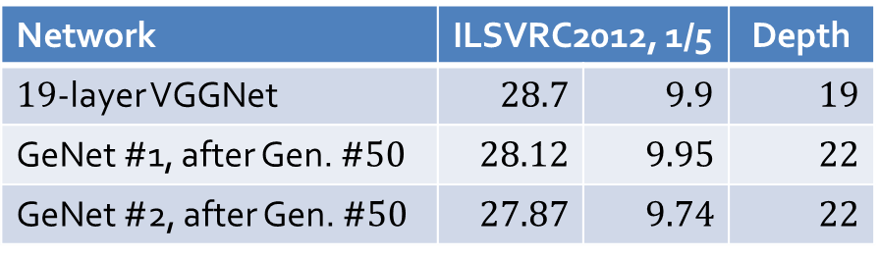
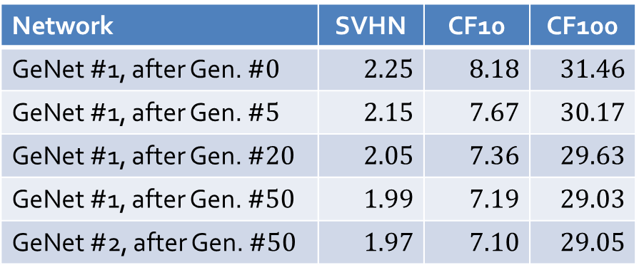
Genetic CNN
Code: 1-01
0
Chain-Shaped
Networks
AlexNet
VGGNet
0
1
1
Generalizing the best learned structures to other tasks
The small datasets with deeper networks
2
3
2
3
4
4
Code: 1-01
Network | SVHN | CF10 | CF100
GeNet #1, after Gen. #$0$ | $$2.25$$ | $$8.18$$ | $$31.46$$
GeNet #1, after Gen. #$5$ | $$2.15$$ | $$7.67$$ | $$30.17$$
GeNet #1, after Gen. #$20$ | $$2.05$$ | $$7.36$$ | $$29.63$$
GeNet #1, after Gen. #$50$ | $$1.99$$ | $$7.19$$ | $$29.03$$
GeNet #2, after Gen. #$50$ | $$1.97$$ | $$7.10$$ | $$29.05$$
Code: 0-01-100
0
0
1
Multiple-Path
Networks
GoogLeNet
1
2
3
2
3
4
4
5
5
Code: 1-01-100
Code: 0-11-101-0001
0
0
Network | ILSVRC2012, 1/5 |  | Depth
$19$-layer VGGNet | $$28.7$$ | $$9.9$$ | $$19$$
GeNet #1, after Gen. #$50$ | $$28.12$$ | $$9.95$$ | $$22$$
GeNet #2, after Gen. #$50$ | $$27.87$$ | $$9.74$$ | $$22$$
1
Highway
Networks
Deep ResNet
1
2
3
2
3
4
5
4
5
6
Code: 0-11-101-0001
6

Slide 16
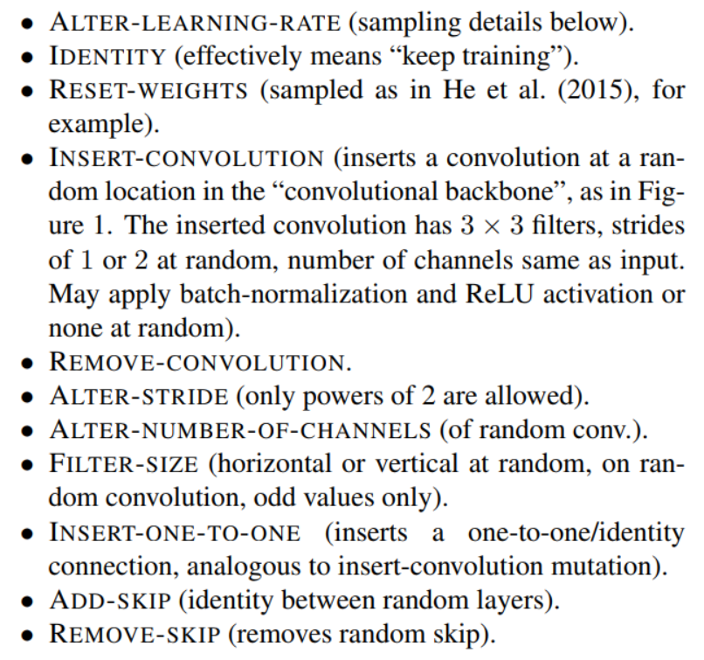

Large-Scale Evolution of Image Classifiers
Modifying the individuals with a pre-defined set of operations, shown in the right part
Larger networks work better
Much larger computational overhead is used: $250$ computers for hundreds of hours
Take-home message: NAS requires careful design and large computational costs
[Real, 2017] E. Real et al., Large-Scale Evolution of Image Classifiers, ICML, 2017.

Slide 17
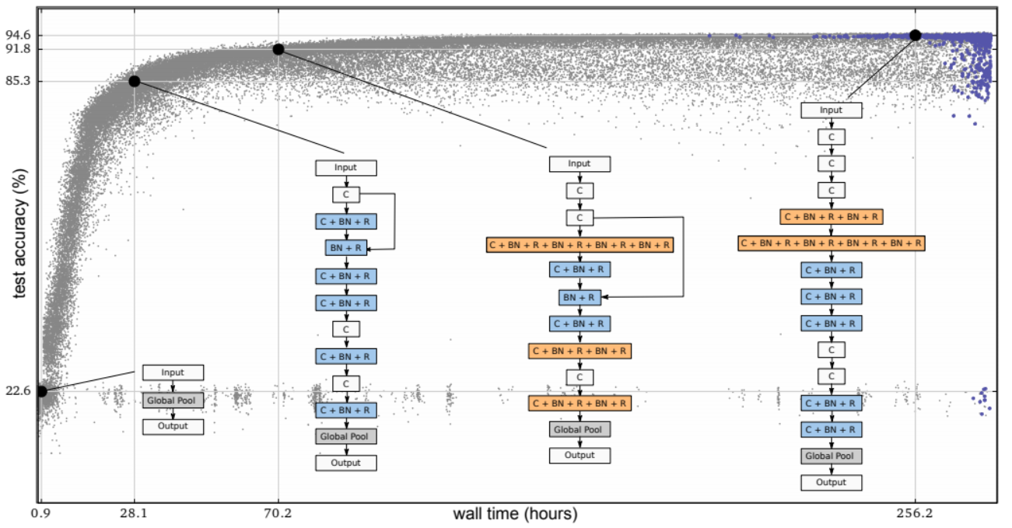
Large-Scale Evolution of Image Classifiers
The search progress
[Real, 2017] E. Real et al., Large-Scale Evolution of Image Classifiers, ICML, 2017.

Slide 18
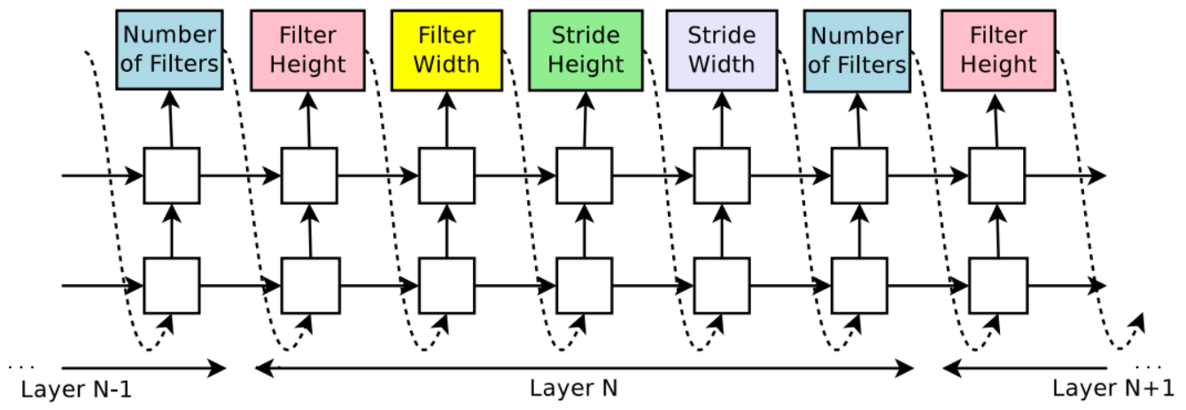
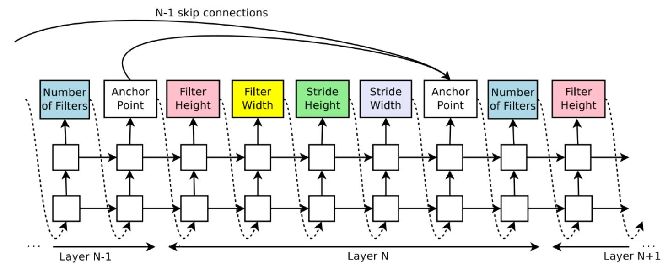

NAS with Reinforcement Learning
Using reinforcement learning (RL) to search over the large space
The entire structure is generated by an RL algorithm or an agent
The validation accuracy serves as feedback to train the agent’s policy
Computational overhead is high
$800$ GPUs for $28$ days (CIFAR)
No ImageNet experiments
Superior accuracy to manually- designed network architectures
[Zoph, 2017] B. Zoph et al., Neural Architecture Search with Reinforcement Learning, ICLR, 2017.

Slide 19
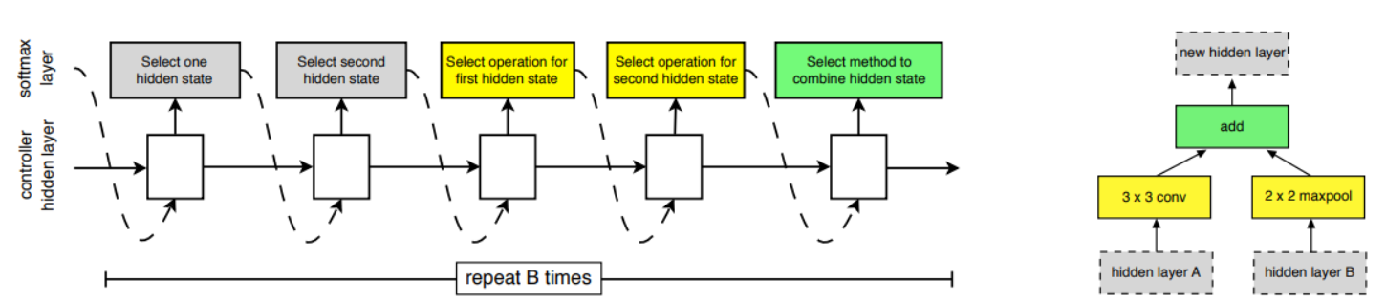

NAS Network
Instead of the previous work that searched everything, this work only searched for a limited number of basic building blocks
The remaining part is mostly the same
Computational overhead is still high
$500$ GPUs for $4$ days (CIFAR)
Good ImageNet performance
[Zoph, 2018] B. Zoph et al., Learning Transferable Architectures for Scalable Image Recognition, CVPR, 2018.

Slide 20
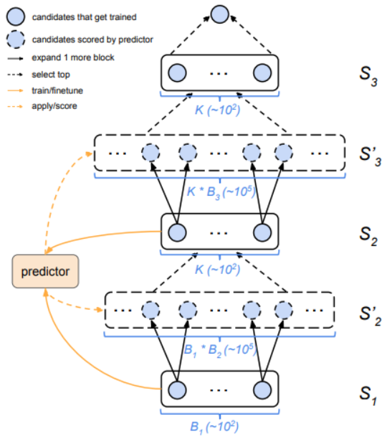

Progressive NAS
Instead of searching over the entire network (containing a few blocks), this work added one block each time (progressive search)
The best combinations are recorded for the next-stage search
The efficiency of search is higher
The remaining part is mostly the same
Computational overhead is still high
$100$ GPUs for $1.5$ days (CIFAR)
Better ImageNet performance
[Liu, 2018] C. Liu et al., Progressive Neural Architecture Search, ECCV, 2018.

Slide 21
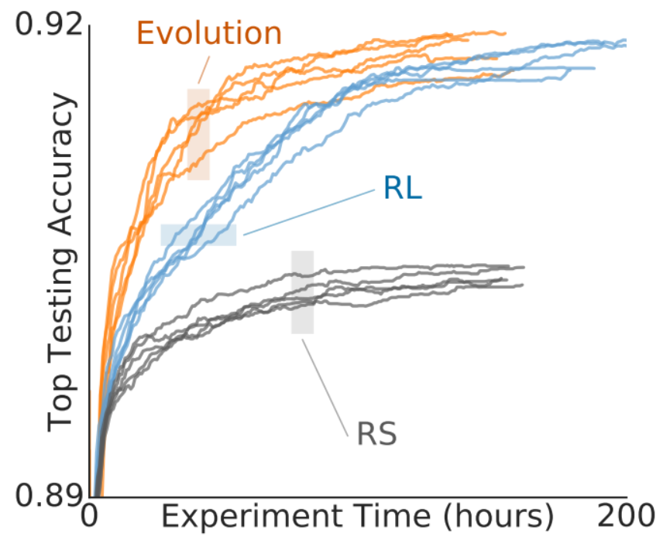
Regularized Evolution
Regularized evolution: assigning “aged” individuals with a higher probability to be eliminated
Evolution works equally well or better than RL algorithms
Take-home message: evolutional algorithms play an important role especially when the computational budget is limited; also, the conventional evolutional algorithms need to be modified so as to fit the NAS task
[Real, 2019] E. Real et al., Regularized Evolution for Image Classifier Architecture Search, AAAI, 2019.

Slide 22
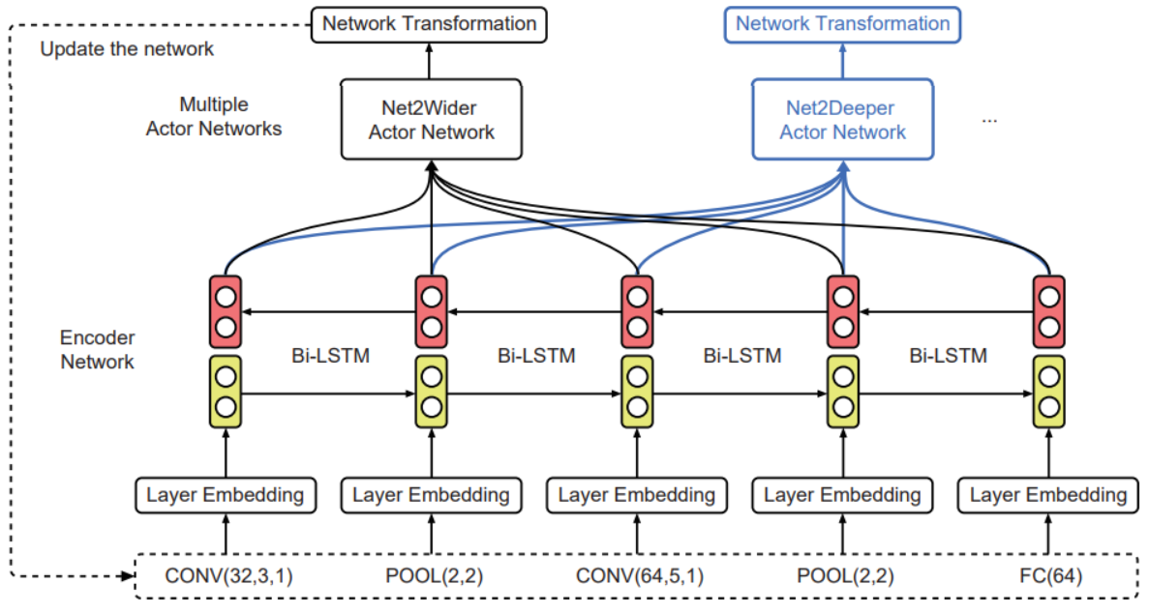

Efficient NAS by Network Transformation
Instead of training a new individual from scratch, this work reused the weights of a prior network (expected to be similar to the current network), so that the current training is more efficient
Net2Net is used for initialization
Operations: wider and deeper
Much more efficient
$5$ GPUs for $2$ days (CIFAR)
No ImageNet experiments
[Chen, 2015] T. Chen et al., Net2Net: Accelerating Learning via Knowledge Transfer, ICLR, 2015.
[Cai, 2018] H. Cai et al., Efficient Architecture Search by Network Transformation, AAAI, 2018.

Slide 23
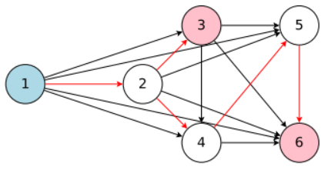
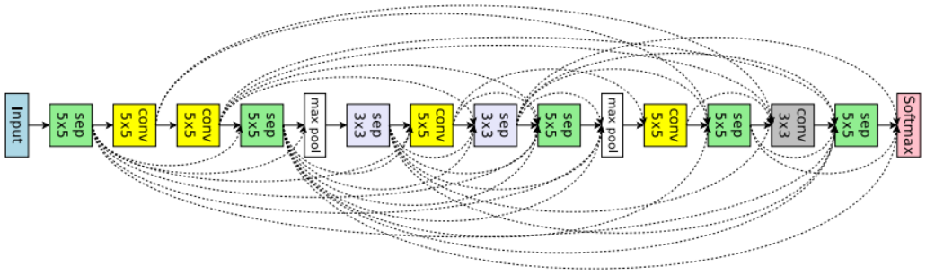

Efficient NAS via Parameter Sharing
Instead of modifying network initialization, this work goes one step forward by sharing parameters among all generated networks
Each training stage is much shorter
Much more efficient
$1$ GPU for $0.45$ days (CIFAR)
No ImageNet experiments
[Pham, 2018] H. Pham et al., Efficient Neural Architecture Search via Parameter Sharing, ICML, 2018.

Slide 24
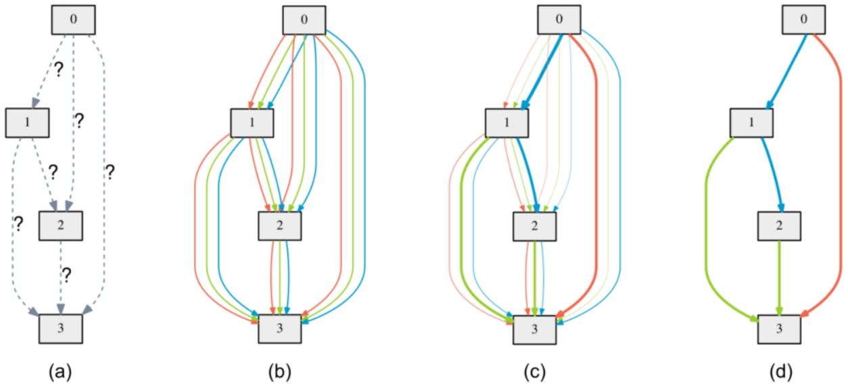

Differentiable Architecture Search
With a fixed number of intermediate blocks, the operator applied to each state is unknown in the beginning
During the training process, the operator is formulated as a mixture model
The learning goal is the mixture coefficients (differentiable)
In the end of training, the most likely operator is kept, and the entire network is trained again
Much more efficient
$1$ GPU for $4$ days (CIFAR)
Reasonable ImageNet results (in the mobile setting)
[Liu, 2019] H. Liu et al., DARTS: Differentiable Architecture Search, ICLR, 2019.

Slide 25
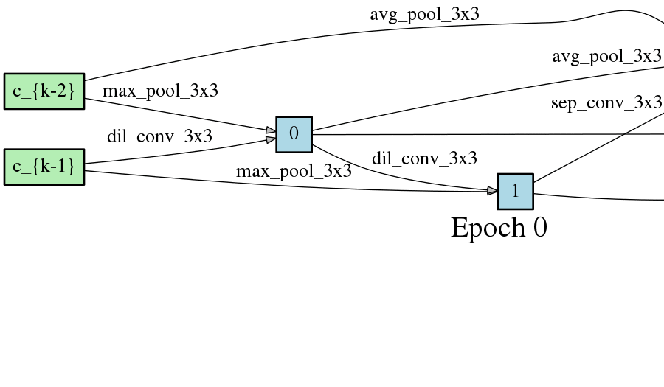
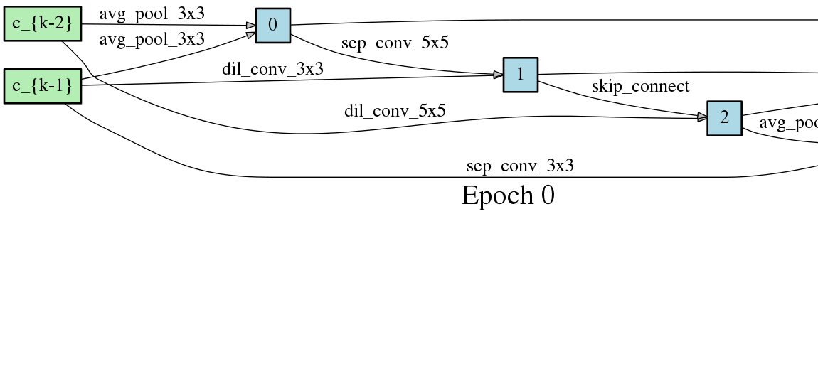
Differentiable Architecture Search
The best cell changes over time
[Liu, 2019] H. Liu et al., DARTS: Differentiable Architecture Search, ICLR, 2019.

Slide 26
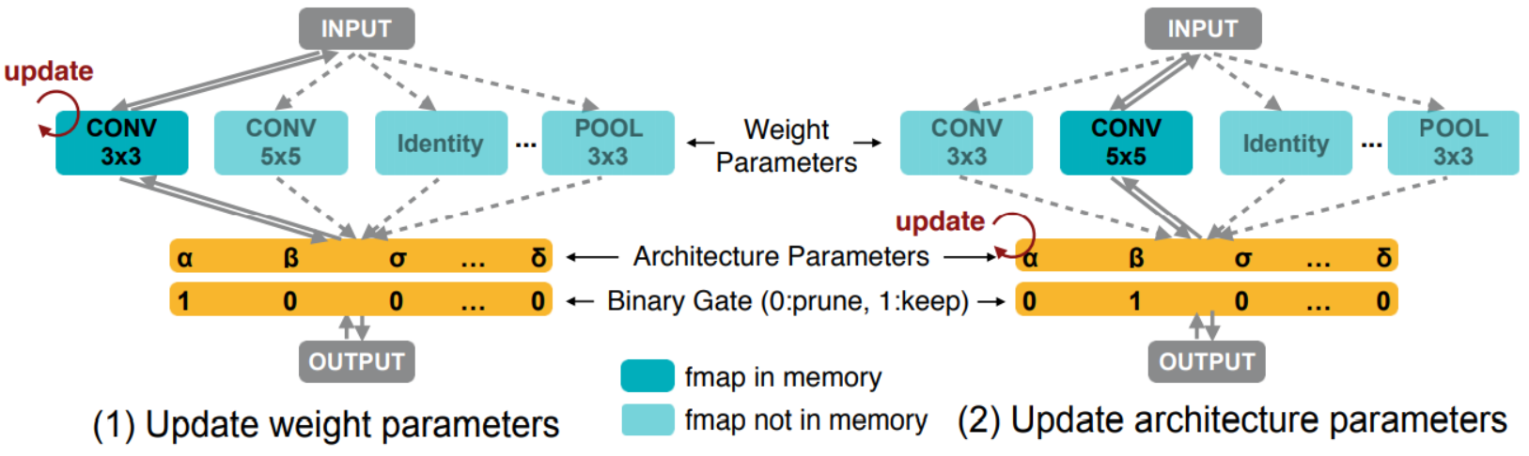

Proxyless NAS
The first NAS work that is directly optimized on ImageNet (ILSVRC2012)
Learning weight parameters and binarized architectures simultaneously
Close to Differentiable NAS
Efficient
$1$ GPU for $8$ days
Reason- able perfor- mance (mobile)
[Cai, 2019] H. Cai et al., ProxylessNAS: Direct Neural Architecture Search on Target Task and Hardware, ICLR, 2019.

Slide 27
More Work for Your Reference
https://github.com/markdtw/awesome-architecture-search

Slide 28
Outline
Introduction
Framework
Representative Work
Our New Progress
Future Directions

Slide 29
Towards a More Stable NAS Approach
We start with the drawbacks of DARTS
There is a depth gap between search and evaluation
The search process is not stable: multiple runs, different results
The search process is not likely to transfer: only able to work on CIFAR10
We proposed a new approach named Progressive DARTS
A multi-stage search progress which gradually increases the search depth
Two useful techniques: search space approximation and search space regularization
[Liu, 2019] H. Liu et al., DARTS: Differentiable Architecture Search, ICLR, 2019.
[Chen, 2019] X. Chen et al., THIS WORK IS A TOP SECRET XD, 2019.

Slide 30
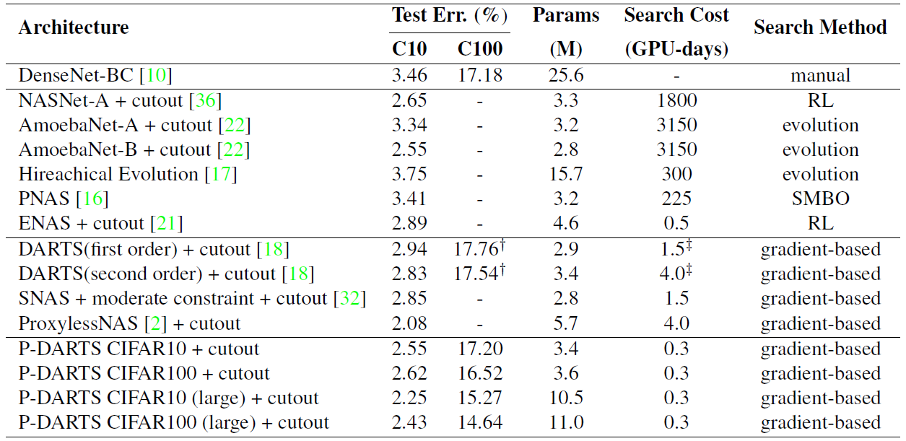
State-of-the-Art Performance
CIFAR10 and CIFAR100 (a useful enhancement: Cutout)
[DeVries, 2017] T. DeVries et al., Improved Regularization of Convolutional Neural Networks with Cutout, arXiv 1708.04552, 2017.

Slide 31
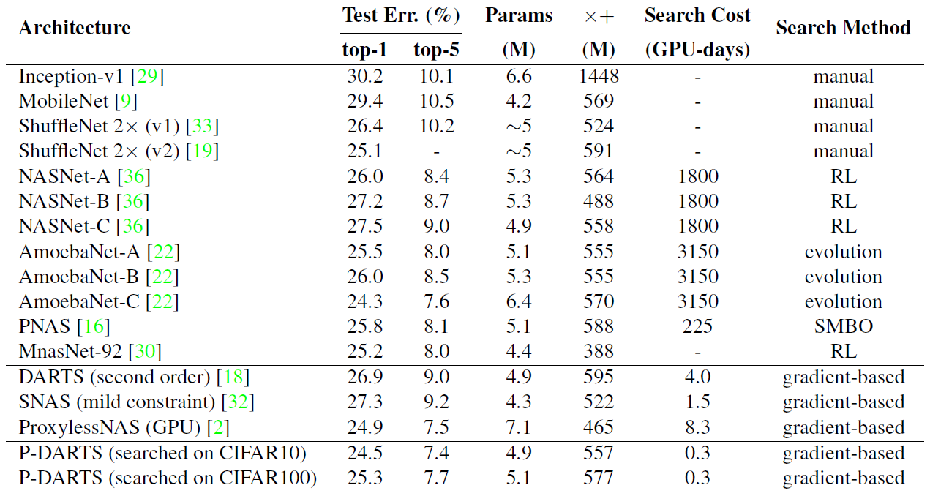
State-of-the-Art Performance
ImageNet (ILSVRC2012) under the Mobile Setting

Slide 32
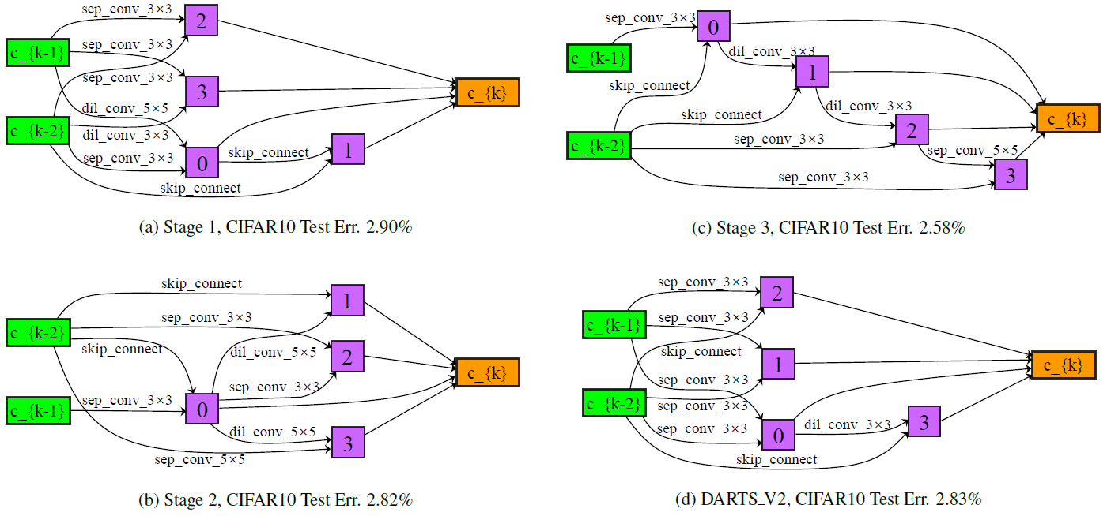
State-of-the-Art Performance
Searched architectures

Slide 33
Outline
Introduction
Framework
Representative Work
Our New Progress
Future Directions

Slide 34
Conclusions
NAS is a promising and important trend for machine learning in the future
NAS vs. fixed architectures as deep learning vs. conventional handcrafted features
Two important factors of NAS to be determined
Basic building blocks: fixed or learnable
The way of exploring the search space: genetic algorithm, reinforcement learning, or joint optimization
The importance of computational power is reduced, but still significant

Slide 35

Related Applications
The searched architectures were verified effective for transfer learning tasks
NASNet outperformed ResNet101 in object detection by $4\%$
Take-home message: stronger architectures are often transferrable
The ability of NAS in other vision tasks
Preliminary success in semantic segmentation
[Zoph, 2018] B. Zoph et al., Learning Transferable Architectures for Scalable Image Recognition, CVPR, 2018.
[Chen, 2018] L. Chen et al., Searching for Efficient Multi-Scale Architectures for Dense Image Prediction, NIPS, 2018.
[Liu, 2019] C. Liu et al., Auto-DeepLab: Hierarchical Neural Architecture Search for Semantic Image Segmentation, CVPR, 2019.

Slide 36
Future Directions
Currently, the search space is constrained by the limited types of building blocks
It is not guaranteed that the current building blocks are optimal
It remains to explore the possibility of searching into the building blocks
Currently, the searched architectures are not friendly to hardware
Which leads to dramatically slow speed in network training
Currently, the searched architectures are task-specific
This may not be a problem, but an ideal vision system should be generalized
Currently, the searching process is not yet stable
We desire a framework as generalized as regular deep networks

Slide 37
Thanks
Questions, please?
Contact me for collaboration and internship ☺

